Slide 1

BEST
Board of European Students of Technology

Slide 2
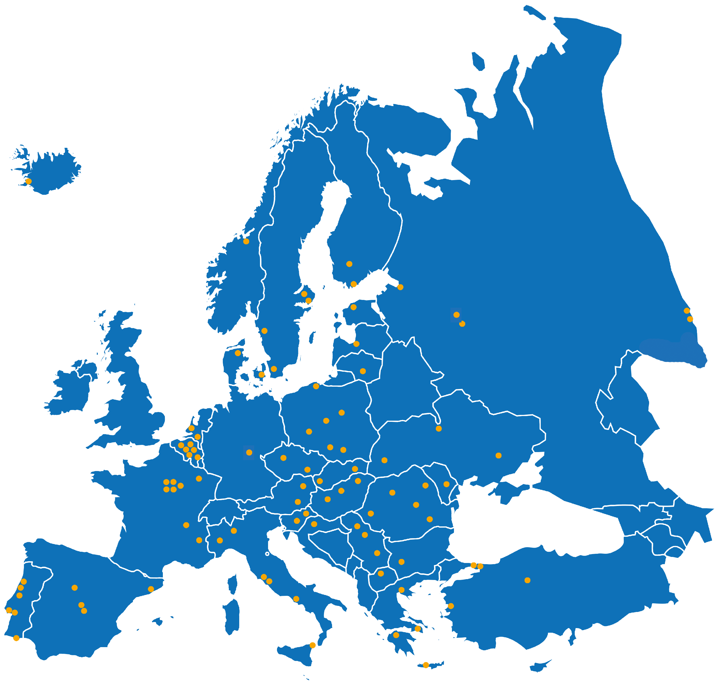

97 technických univerzit
34 zemí
= 97 LBGs

Slide 3
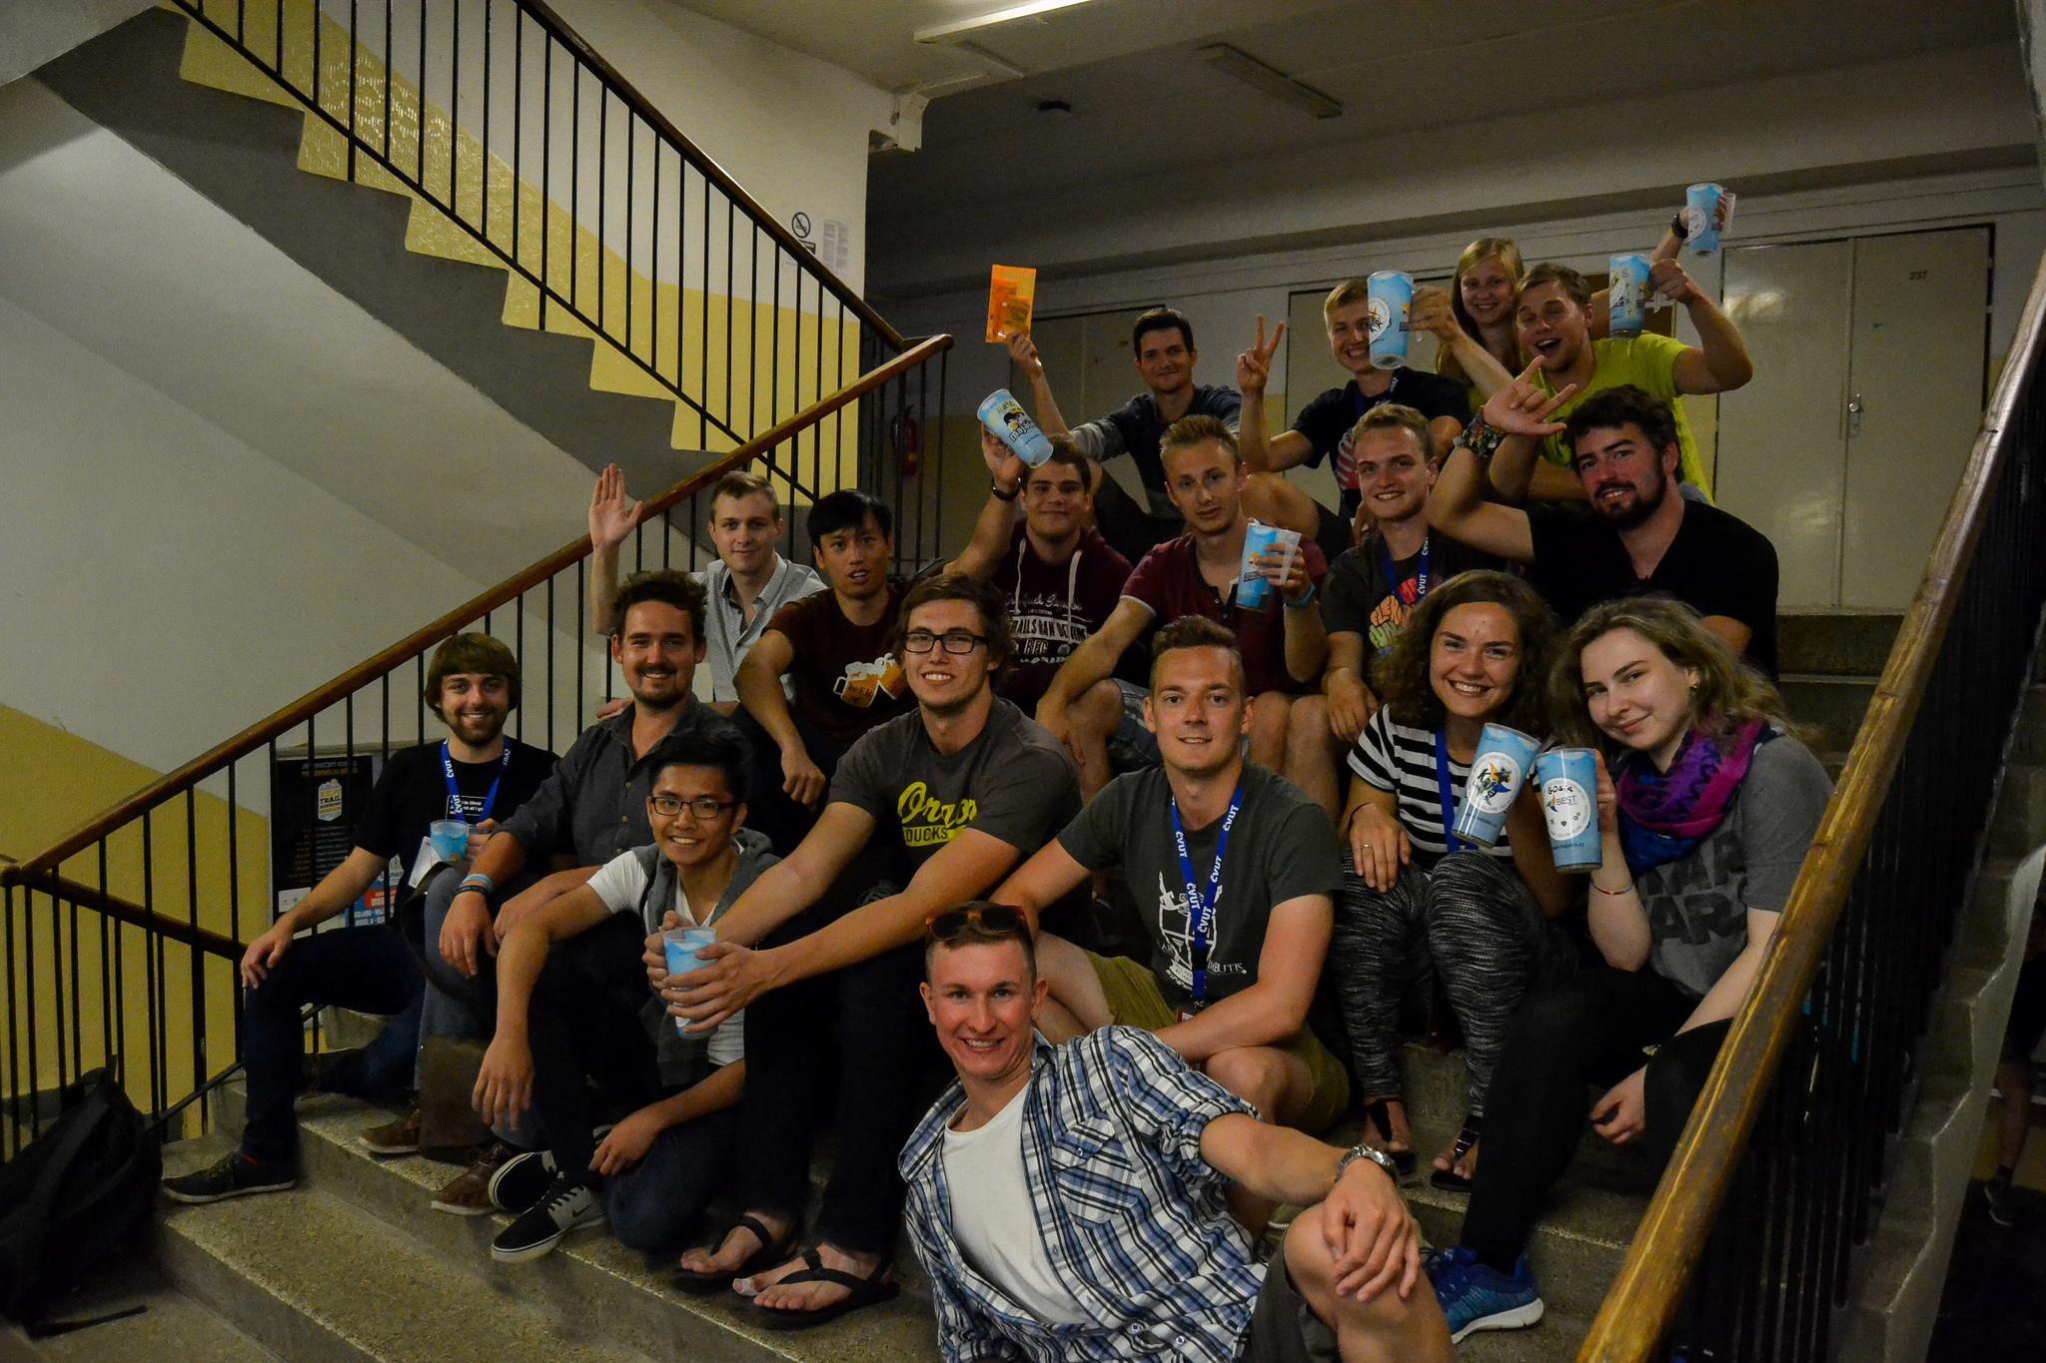
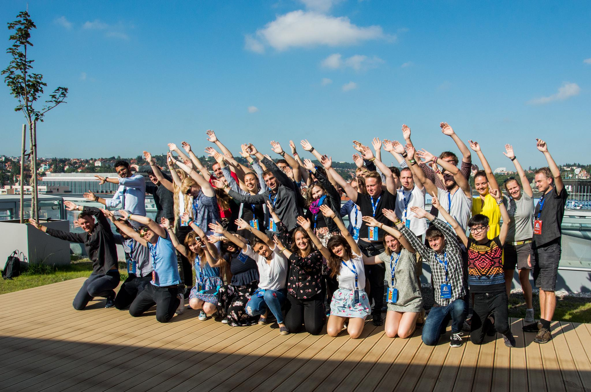
Courses Spring, Summer, Autumn, Winter
DL: 14.10. ...season winter www.best.eu.org

Slide 4
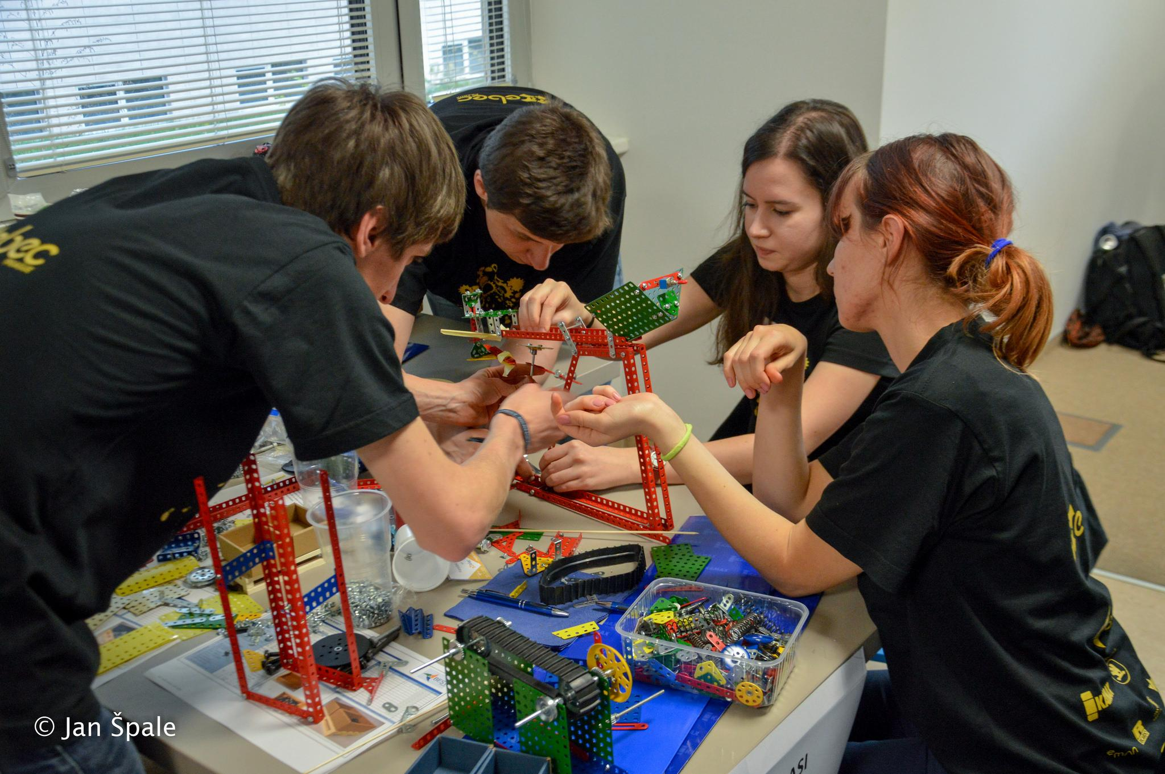
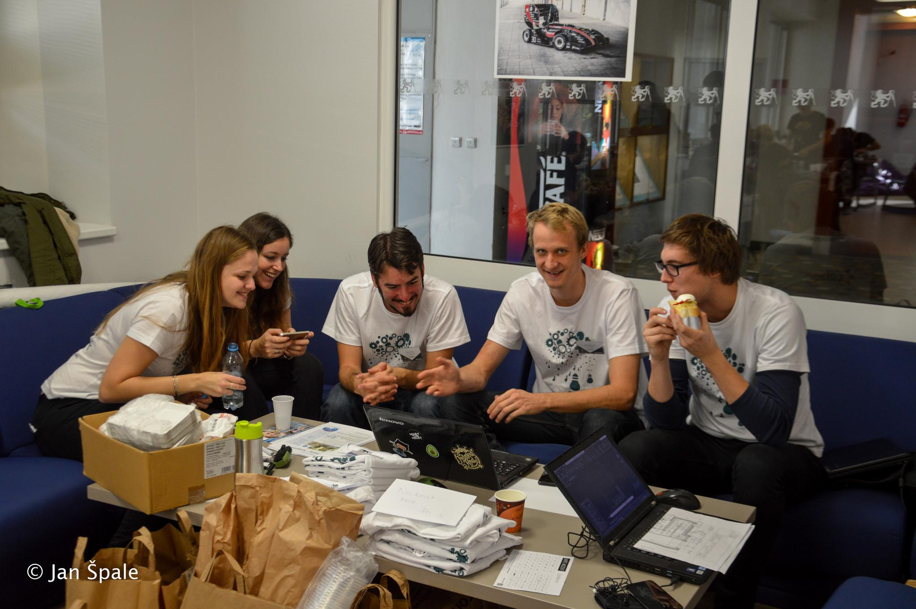
Competitions EBEC & UnIT

Slide 5
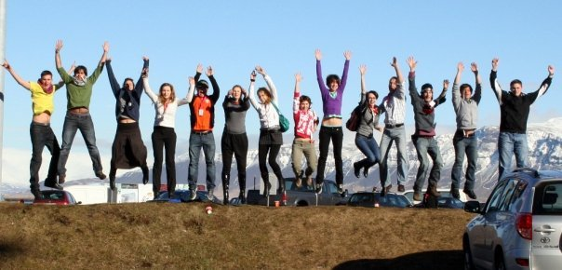
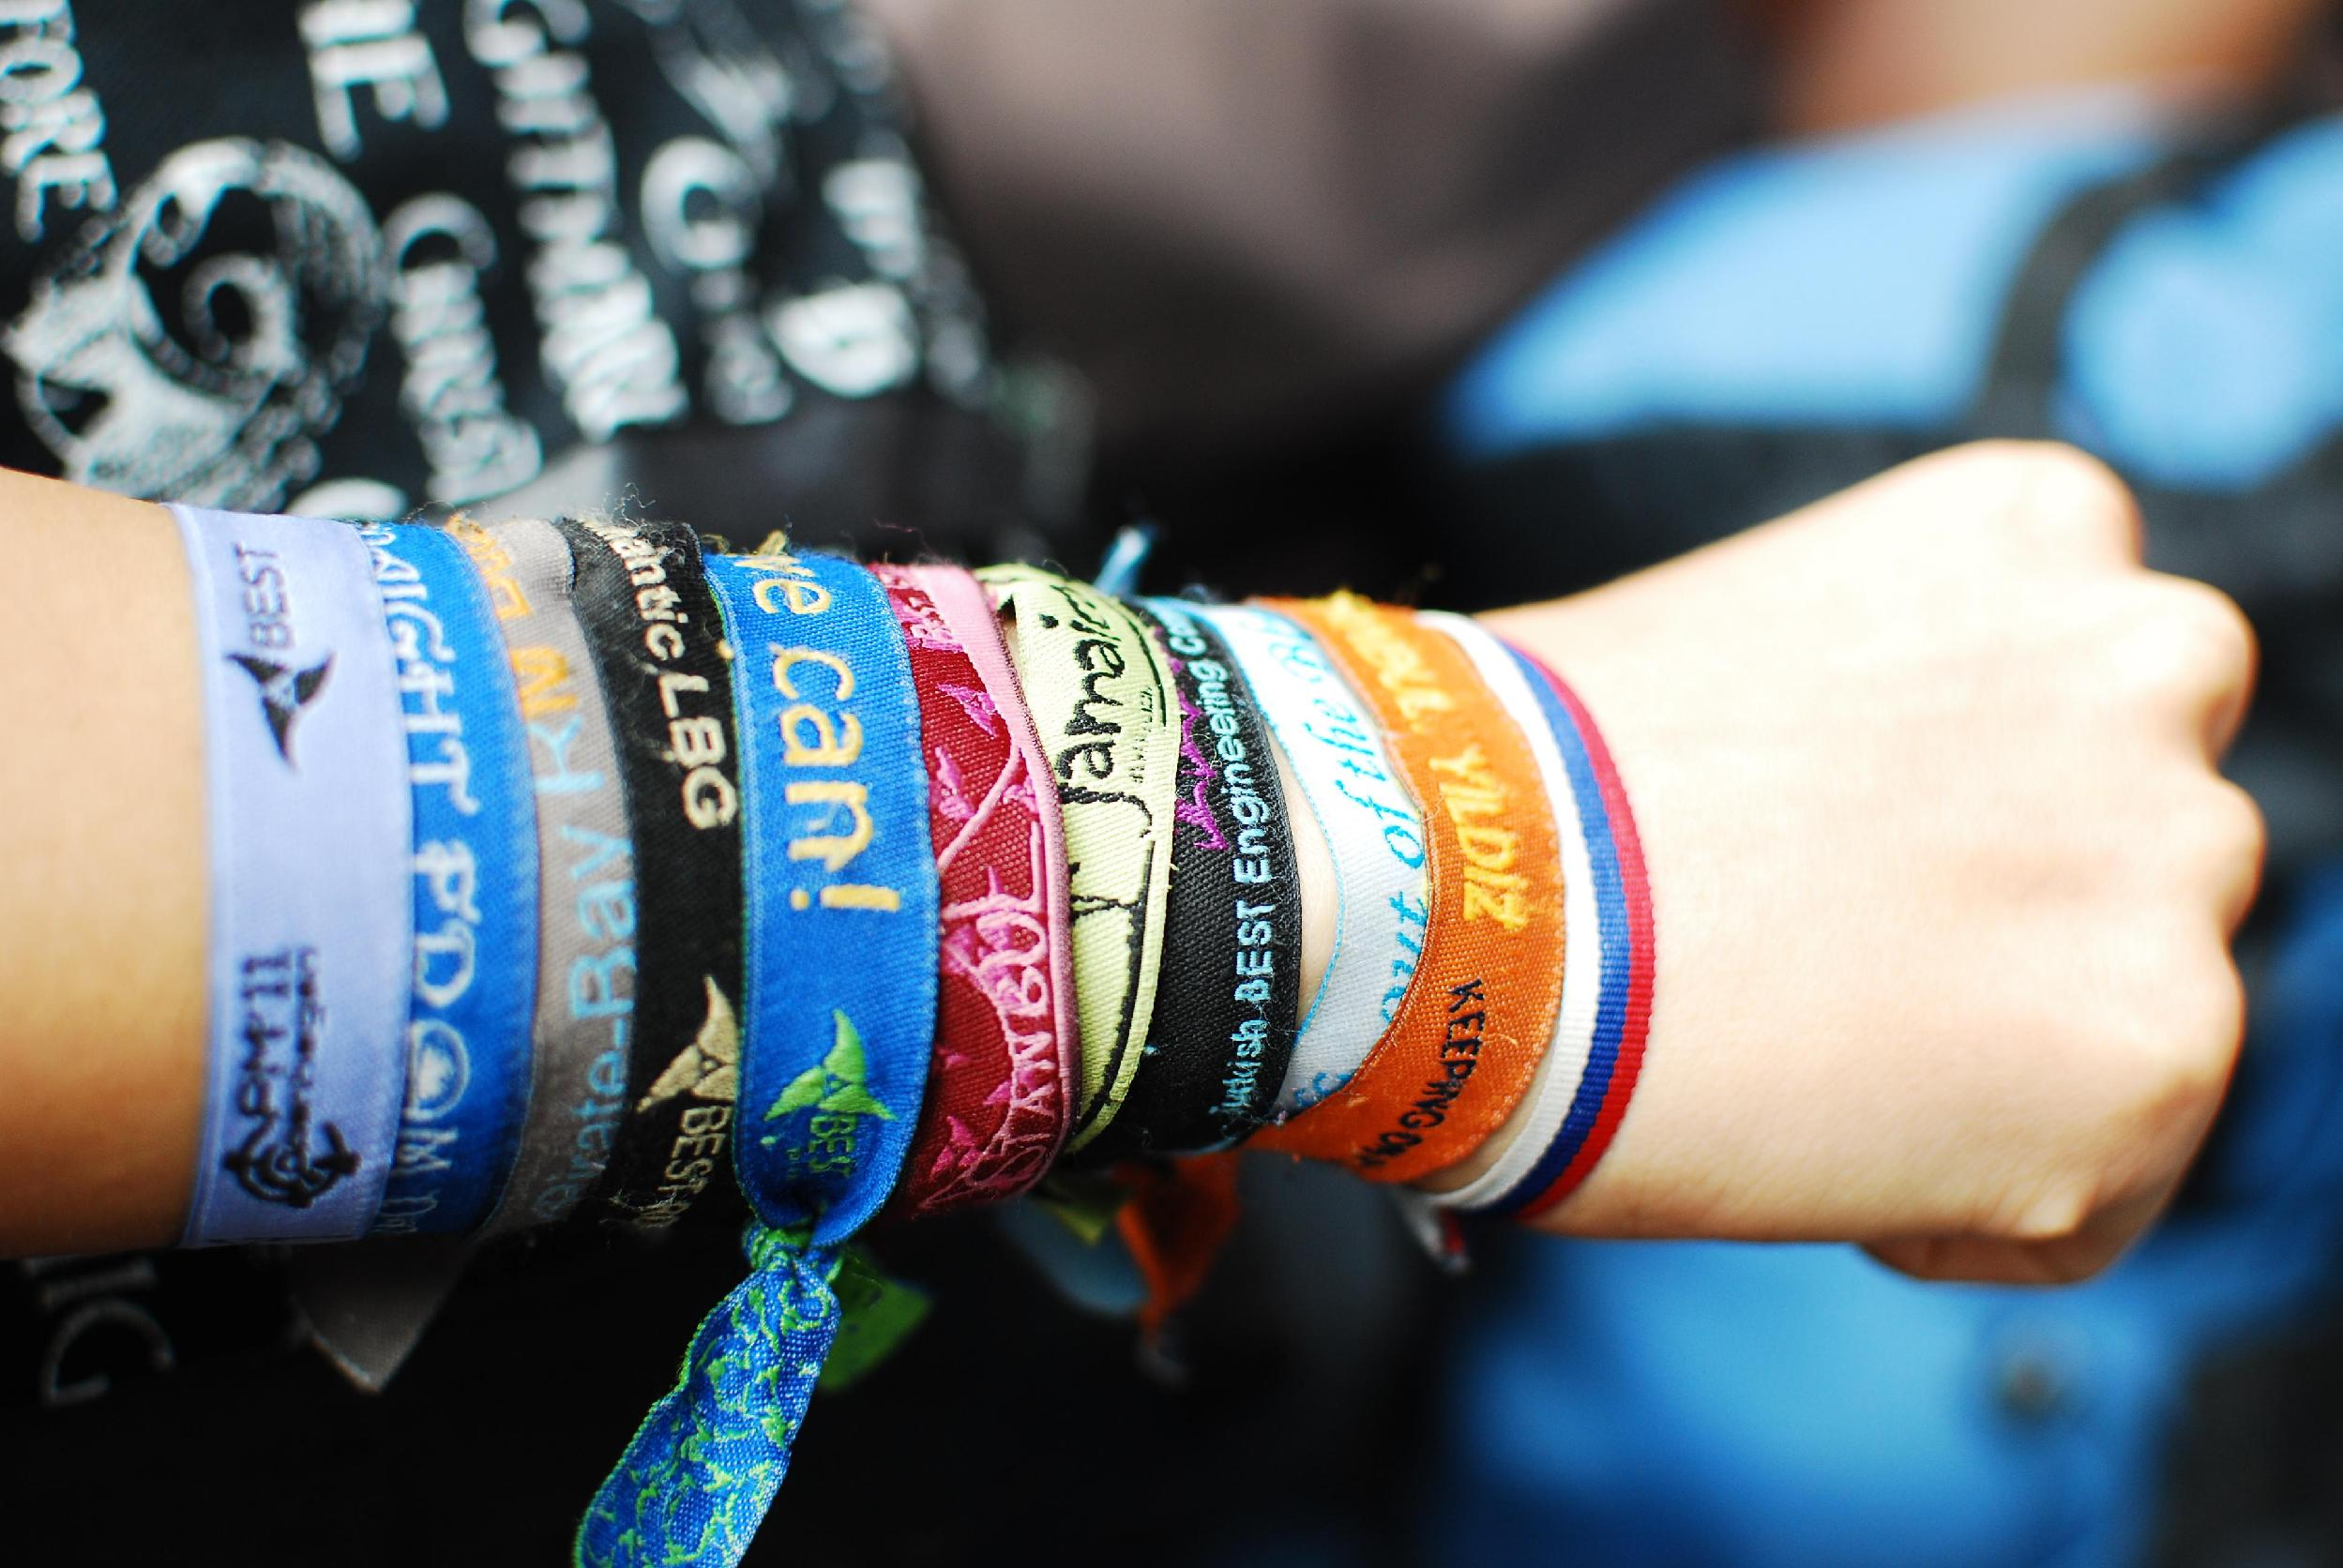
Events for members
Cultural Exchanges
Regional Meetings
General Meetings
Motivational Weekend
Actions, meeting people, fun

Slide 6
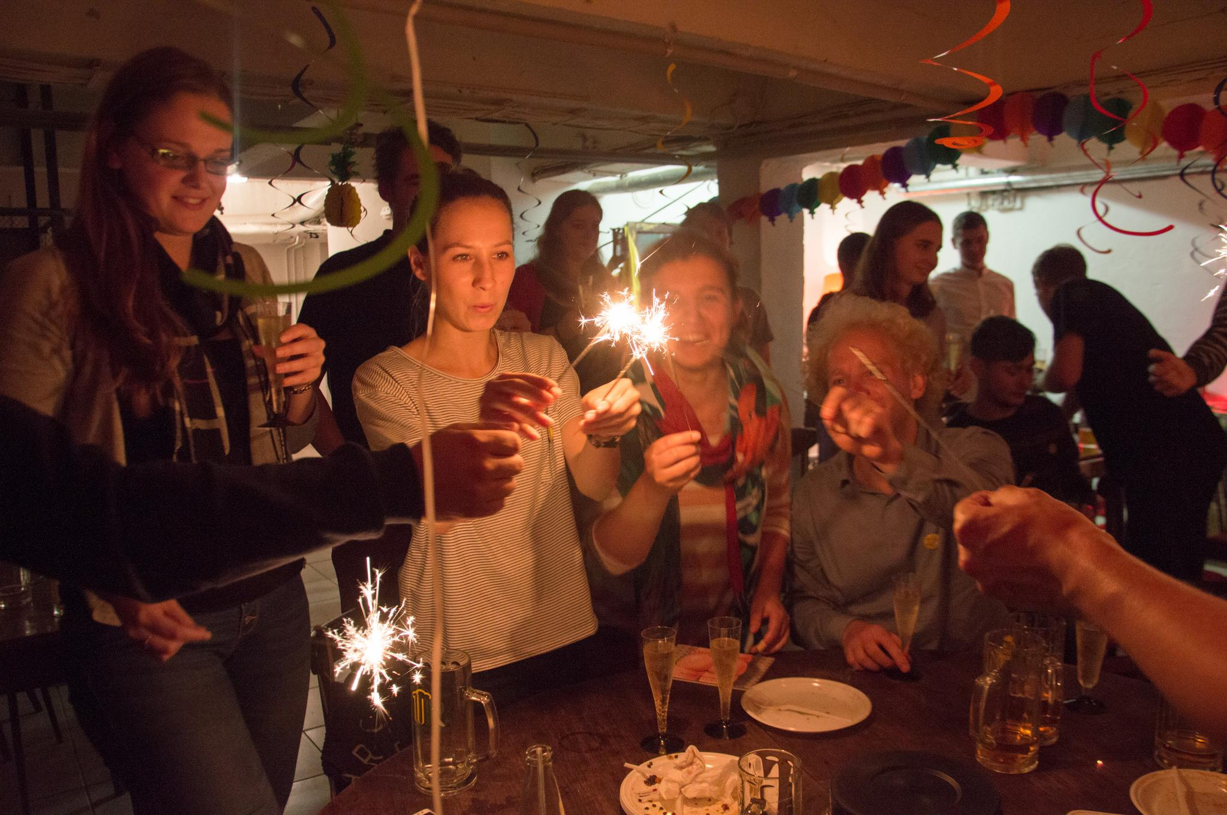
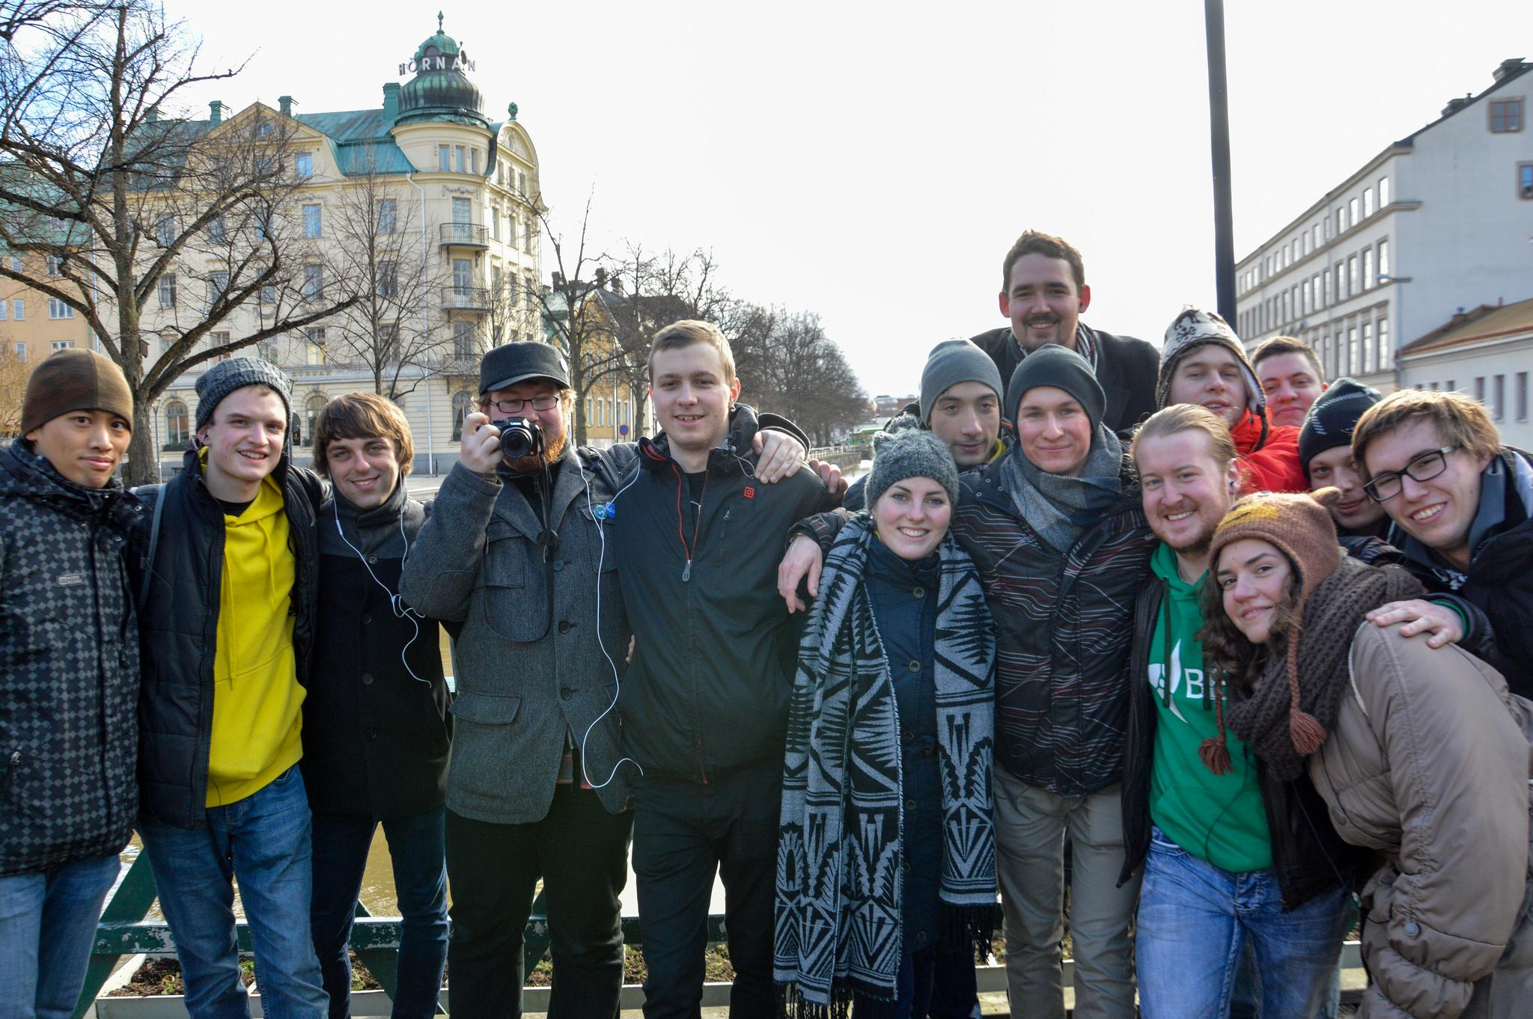
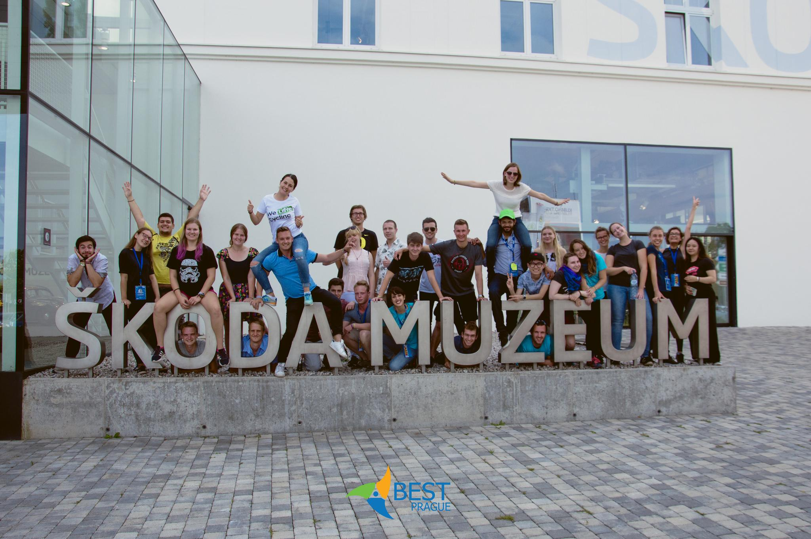
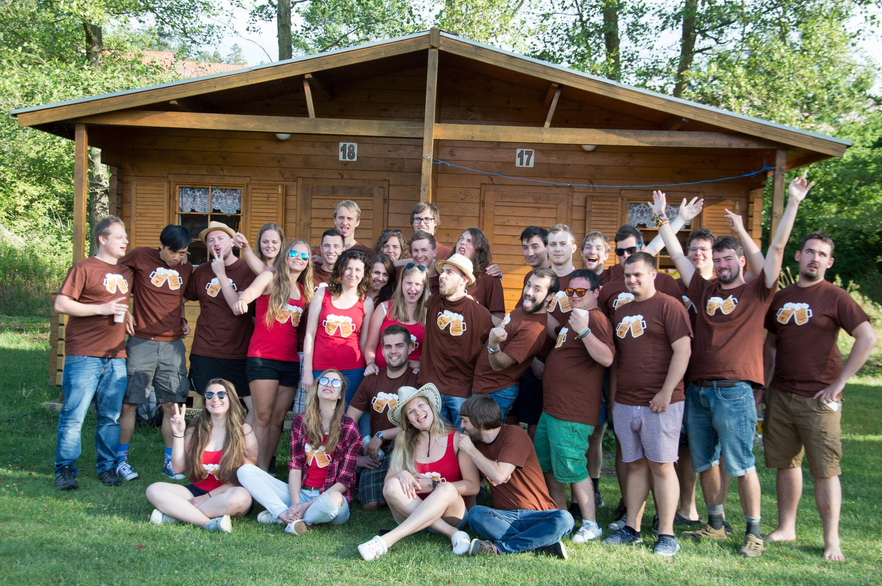
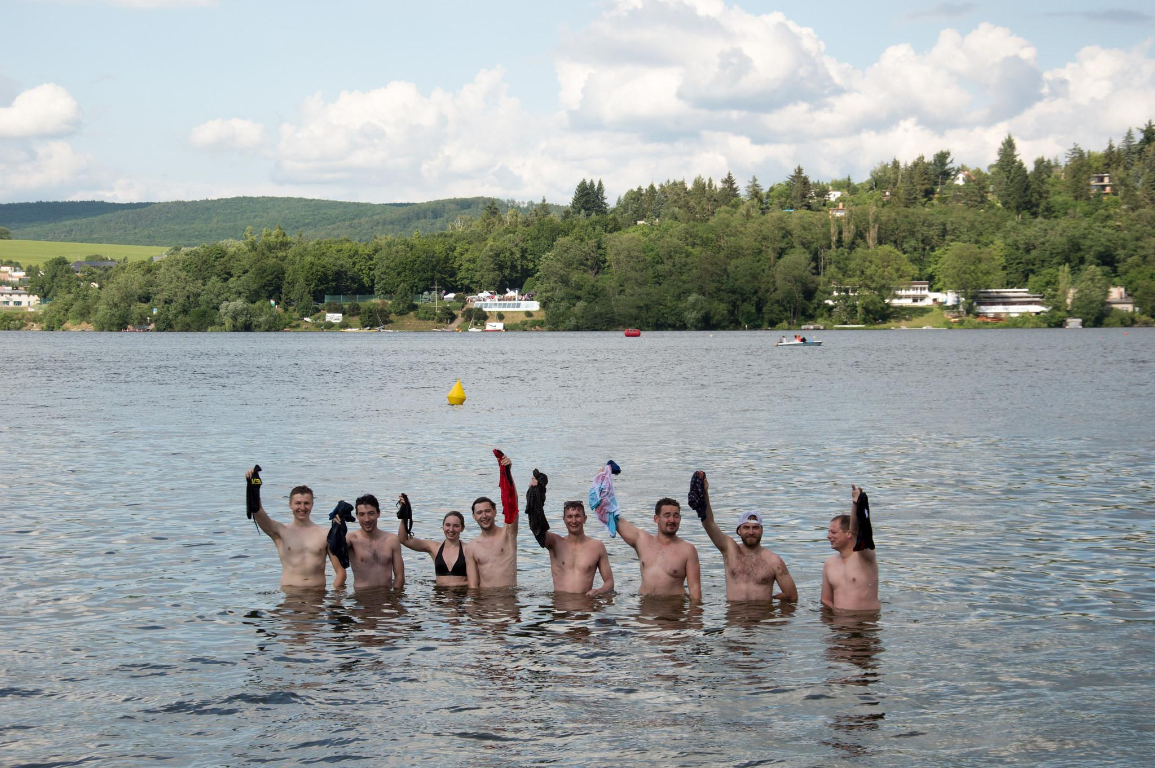
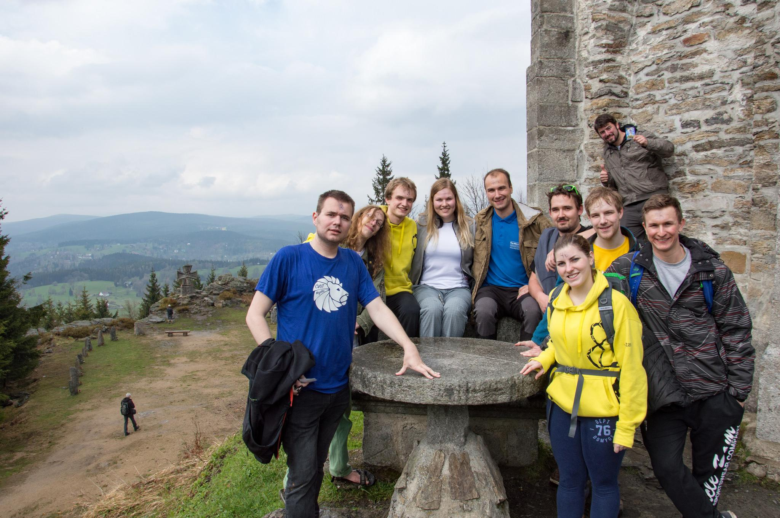
From our events

Slide 7
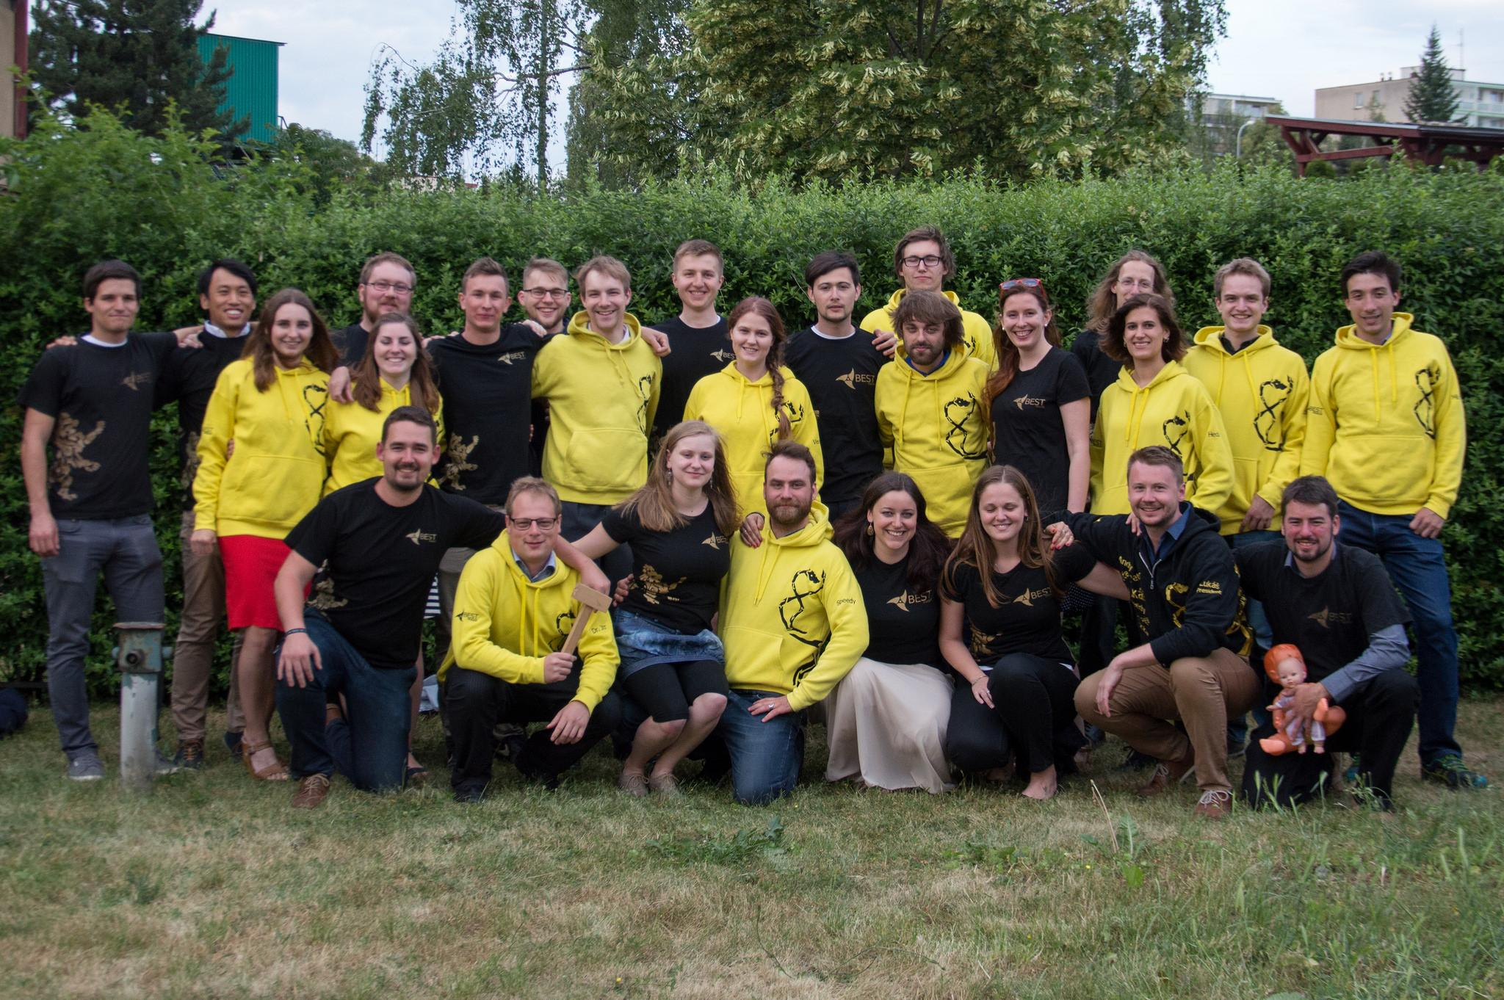
hr@bestprague.cz

Slide 8




BEST
Web:
www.best.eu.org
www.bestprague.cz
BESTPragueCTU
@BESTPrague
@BEST_Prague

